Slide 1
Online Retail Analysis
Customer Behaviour & Market Insights

Slide 2
Business Problem
Understand customer purchasing behaviour
Identify:
Key customers
Popular products
Differences across countries
Key Goal: Drive business growth using data insights

Slide 3
Dataset Overview
500,000+ transactions
Key variables:
Customer ID
Product description
Quantity & price
Country
Insight: Large, rich dataset for behavioural analysis
Data Cleaning
500,000+ transactions
Key variables:
Customer ID
Product description
Quantity & price
Country
Insight: Large, rich dataset for behavioural analysis

Slide 4
Key Metric
Created: TOTAL_SALES = Quantity × Unit Price
Insight: Used to measure revenue and customer value

Slide 5
Product Insight
Top products:
Home décor
Gift items
Common words:
Vintage, Heart, Set, Pink
Insight: Strong demand for decorative and lifestyle products

Slide 6
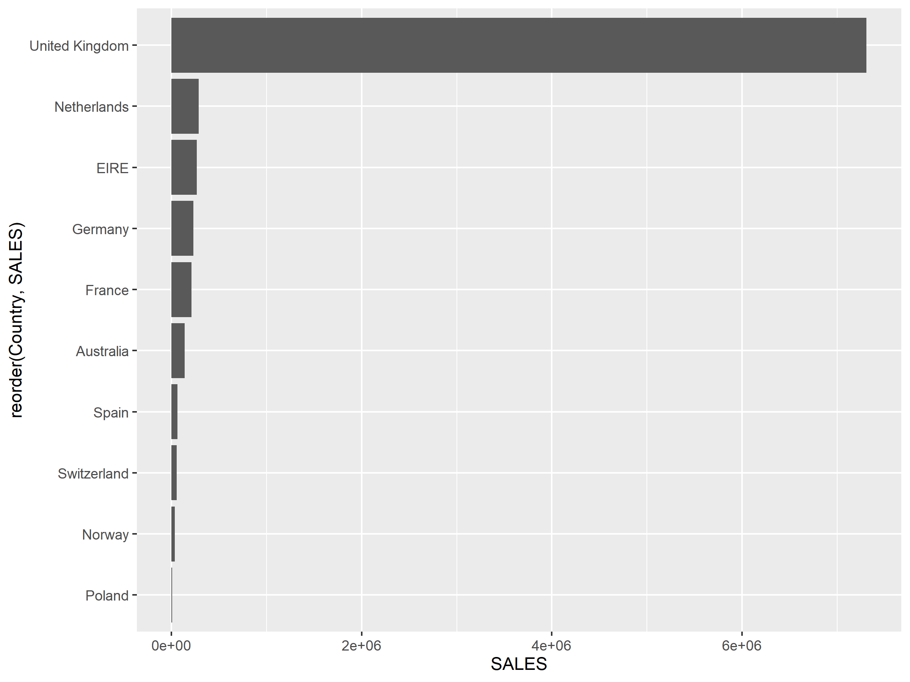
Sales by Country
UK dominates revenue
Top markets:
Netherlands
EIRE
Germany
France
Insight: International markets contribute meaningful revenue

Slide 7
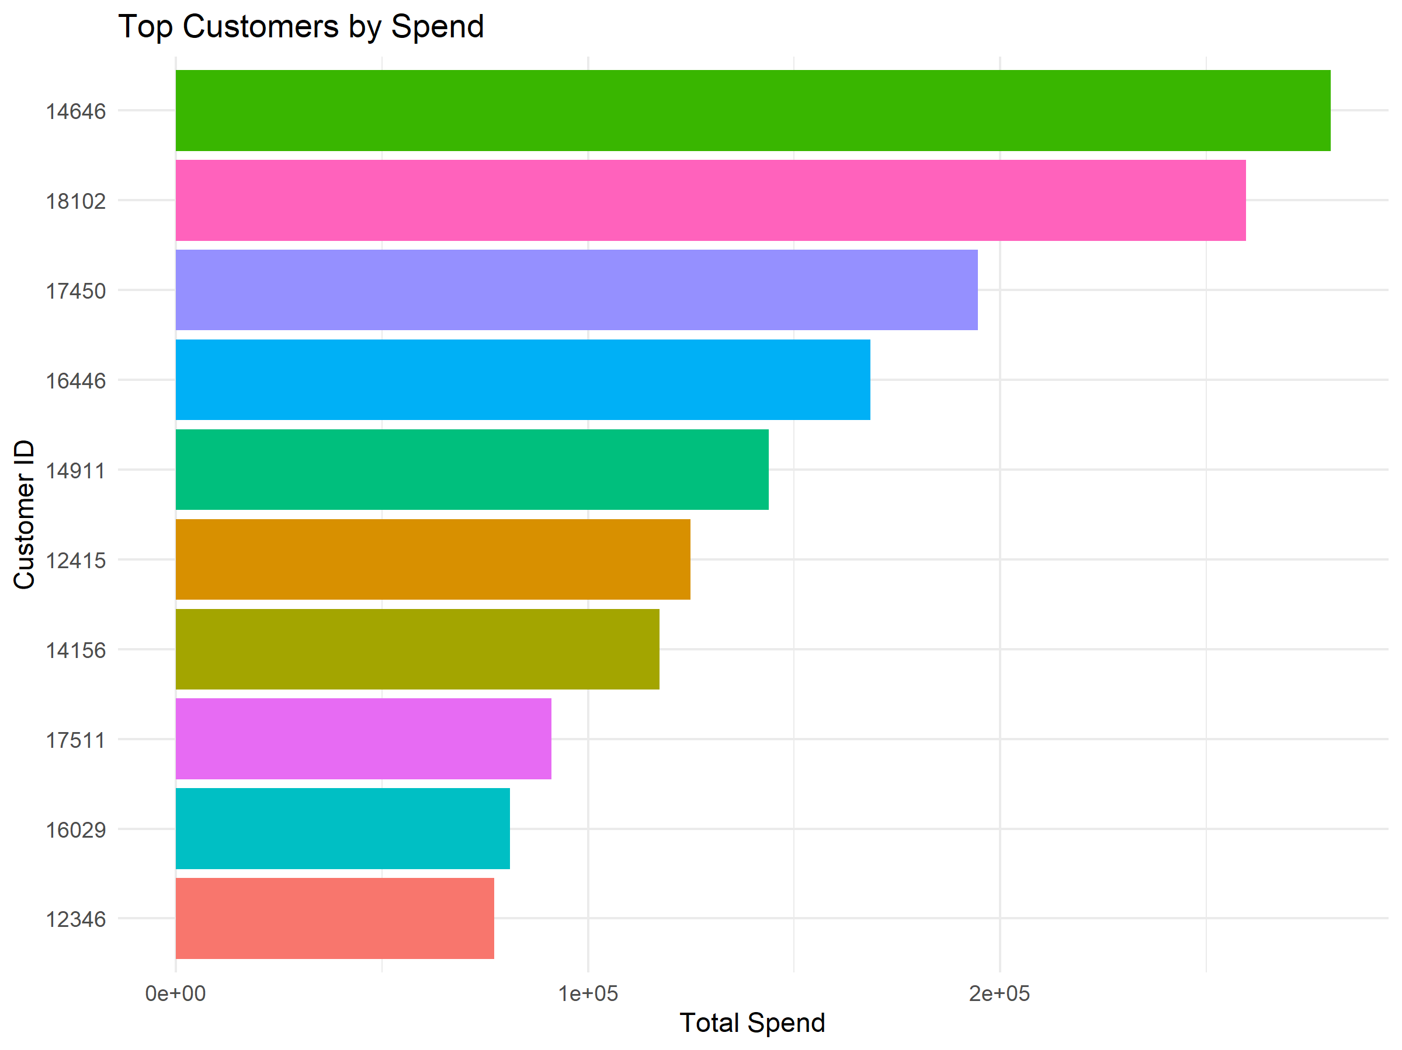
Top Customers
Small group drives most revenue
Insight: Follows Pareto Principle (80/20 rule)
Focus on high-value customers
CUSTOMER BEHAVIOUR
High spend markets:
EIRE
Netherlands
Singapore
High volume buyers:
Netherlands
EIRE
Insight: Some markets behave like wholesale buyers

Slide 8
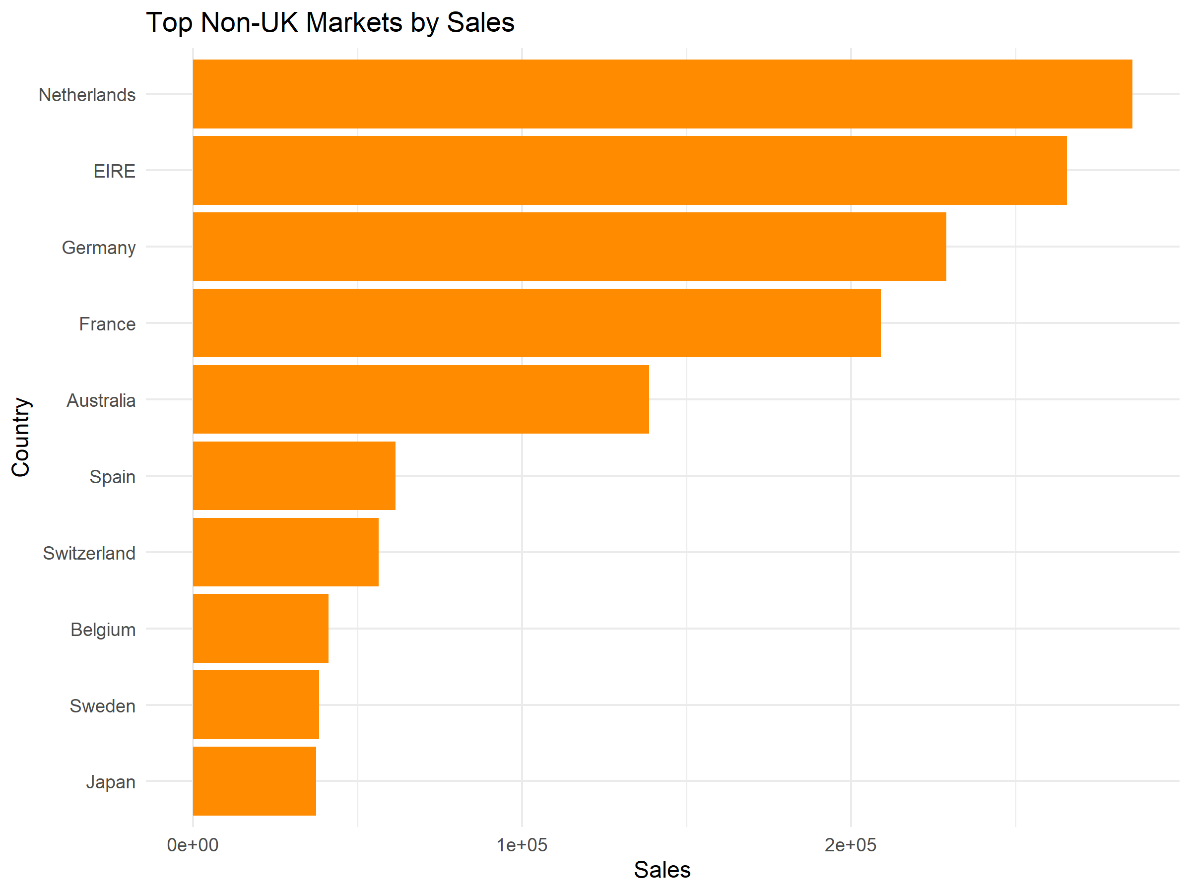
Non-UK Market Focus
Top non-UK markets:
Netherlands
EIRE
Germany
Insight: Strong opportunity for international expansion
MARKET SEGMENT
High Volume + High Spend → Wholesale markets
Low Volume + High Spend → Premium markets
Low Volume + Low Spend → Emerging markets
Insight: Different strategies needed per market

Slide 9
Price Sensitivity
High price markets:
Singapore
Lebanon
Lower price sensitivity varies by country
Insight: Pricing should be market-specific

Slide 10
Key Insights + Conclusion
UK dominates but hides global opportunities
Few customers drive most revenue
Strong demand for décor products
International markets show growth potential
_____
Growth lies in:
International expansion
Customer-focused strategy
Data-driven decisions

Slide 11
Recommendations
Expand into:
Netherlands
EIRE
Singapore
Target high-value customers
Focus on décor & gift products
Use country-specific pricing

